Slide 1
CMTS Card Status Monitor
SDN Hackathon CRDC 2015
System-Infra Team
Xiaosong Chen, Gang Ma, Hao Zhang, Zhaoqi Wu, Xiaoyu Deng, Jian Hu
July 29, 2015

Slide 2
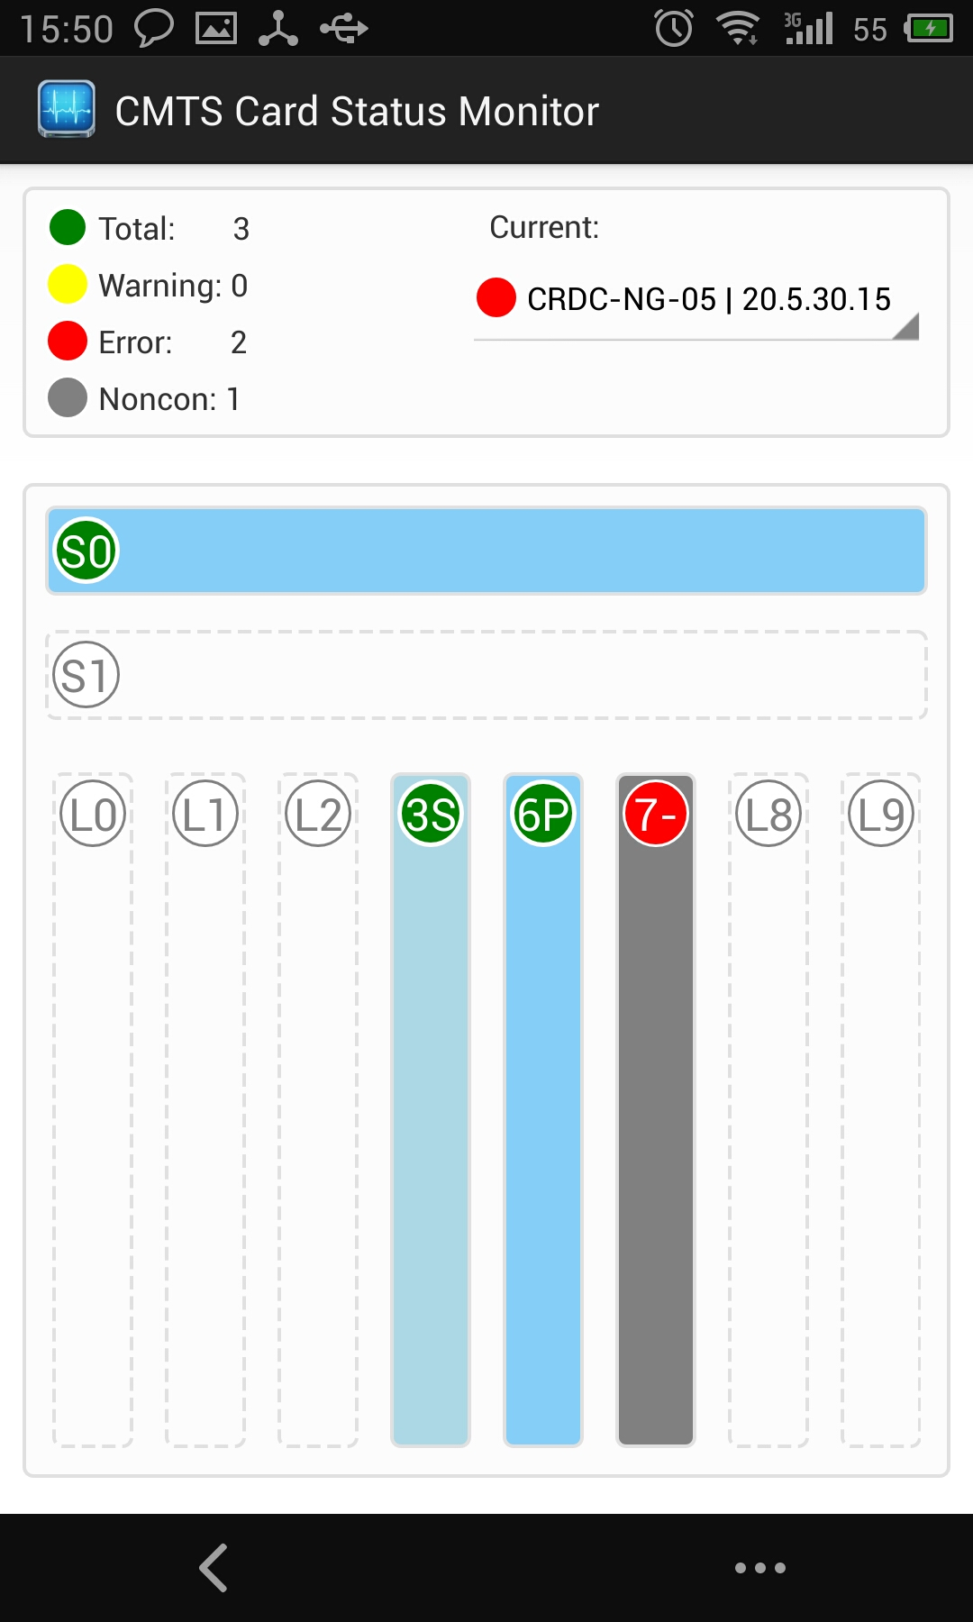
Agenda
Product Overview
Feature Highlight
System Design
Live Demo
Q & A

Slide 3
Product Overview
This mobile App provides real time status monitoring of CMTS LCs, SUPs, environment and CM status.
It gives TAC engineer/Site technician the unique advantage of monitoring CMTS status on a 7x24 basis, with push of critical alarm.

Slide 4
Feature Highlight
SUP status monitoring
Graphics display
Real time SUP on/off status monitoring
IOS image display
Different display for primary SUP and secondary SUP
LC status monitoring
Graphics display
Real time LC on/off status monitoring
Different display for primary LC and secondary LC

Slide 5
Feature Highlight - continued
Chassis environment / sensor status monitoring
List alarm for all sensor on each LC and SUP
Differentiated alarm status including critical, major and minor alarm.
CM offline monitoring
Alert user when offline CM count above threshold on MD base
Wipe between multiple chassis

Slide 6
Future Enhancement
CM flap monitoring
Alert CM flap behavior and list the top 5 MD with most flapping CMs.
Crash / Traceback log detect
Alert user on crash and traceback.
Auto upload full log, crashinfo and core file to backend.
Monitor CPU / Memory status
Alert user when CPU / Memory higher than a user configurable threshold.
Log CPU / Memory utilization on a time-based graphics table.
And More…

Slide 7
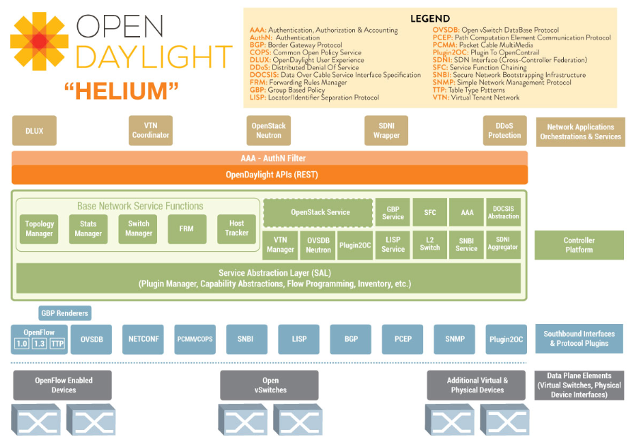

System Design

Slide 8


Slide 9

Live Demo

Slide 10
Q & A

